Slide 2
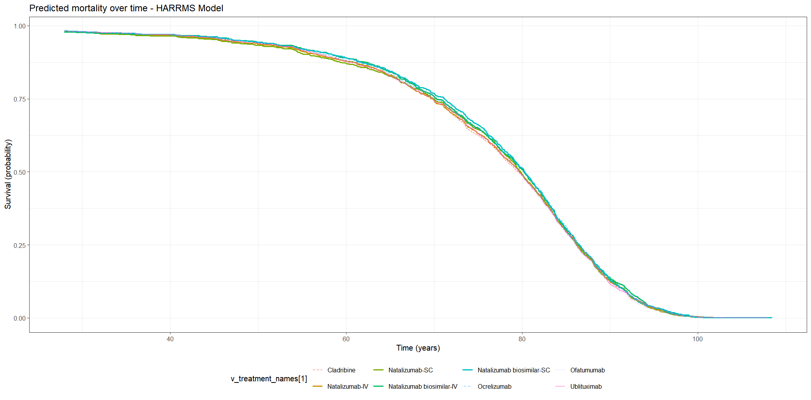
WARDEN

Slide 3
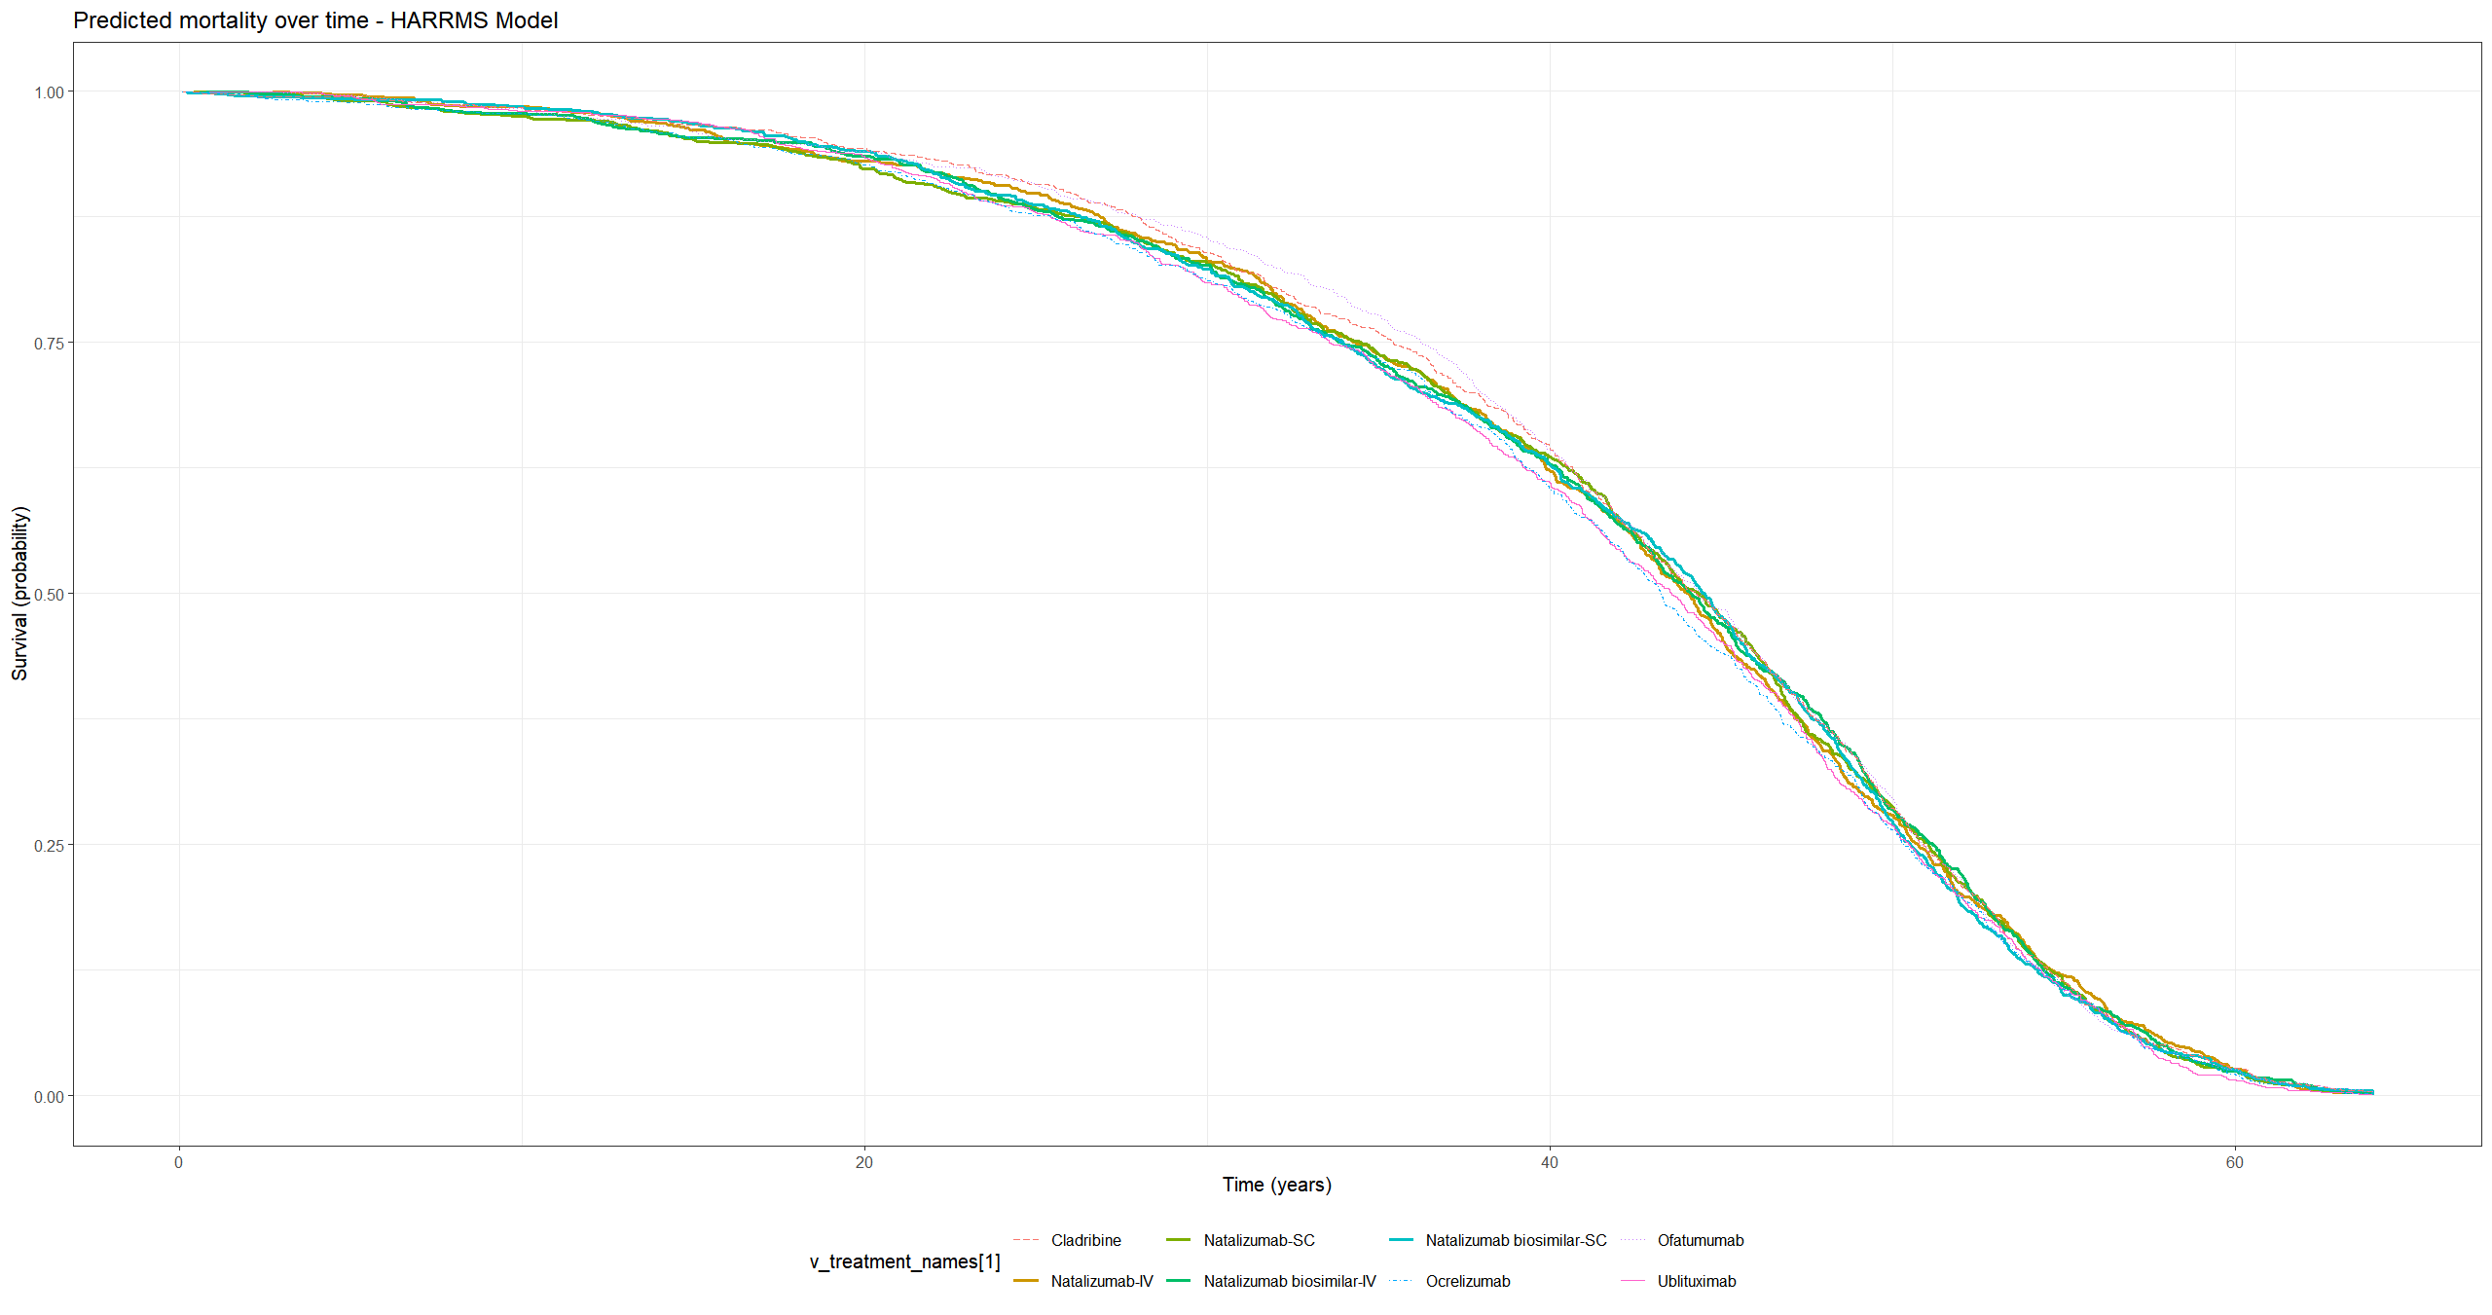
DESCEM

Slide 4
WARDEN vs DESCEM
WARDEN

